Slide 1
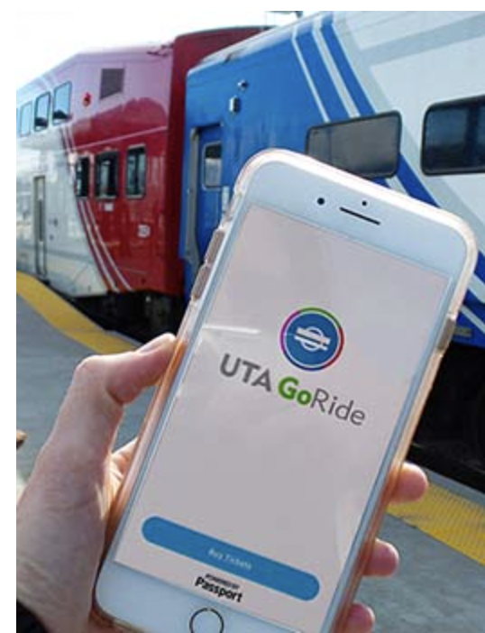
AADHITHYA CHRIS HASITHA MEGHANA

Slide 2

About UTA GoRide
UTA GoRide - UTA’s official mobile ticketing app! It provides a convenient solution to pay for your transit fare with your smartphone.
Customers can use the mobile ticketing app UTA GoRide to plan their trip and purchase fare products for specific UTA services.
Riders can purchase one-way tickets through the app. Once passengers are prepared to board their bus or train, they need to activate their fares.
If the app isn’t responsive, customer can try logging out of the app and logging back in first. If they continue to experience technical difficulties, navigate to the “Help” tab in the app, or contact UTA Customer Service at 1-801-RIDE-UTA (743-3882) or http://www.rideuta.com/Rider-Info/Contact-Us.

Slide 3
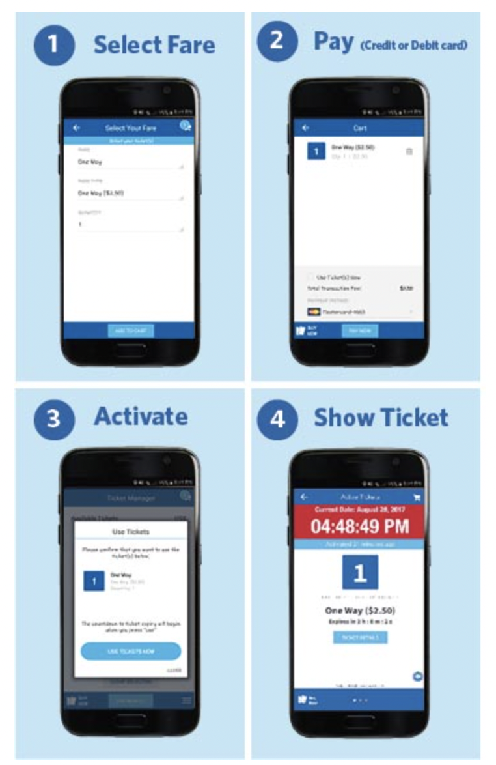
HOW TO USE THE UTA GORIDE APP :

Slide 4
KEY BUSINESS REQUIREMENTS
Once a customer completes signing up in the mobile application with phone number, a unique Customer ID is generated.
The mobile application provides three types of one-way routes: One-way, Express & Park City for the customer to choose from.
Customers have discounted prices depending on which category they fall into like 65+, Medicare Holders, Disabled etc..
Customers can activate their tickets and can use them within their validity period.
Customers can check the status of the ticket if its Active, Inactive or Expired on the app.
Customers can also check their previous ride history in the Rider history section.
Additionally, customers can also provide a rating/feedback to UTA about their user experience with the app.

Slide 5
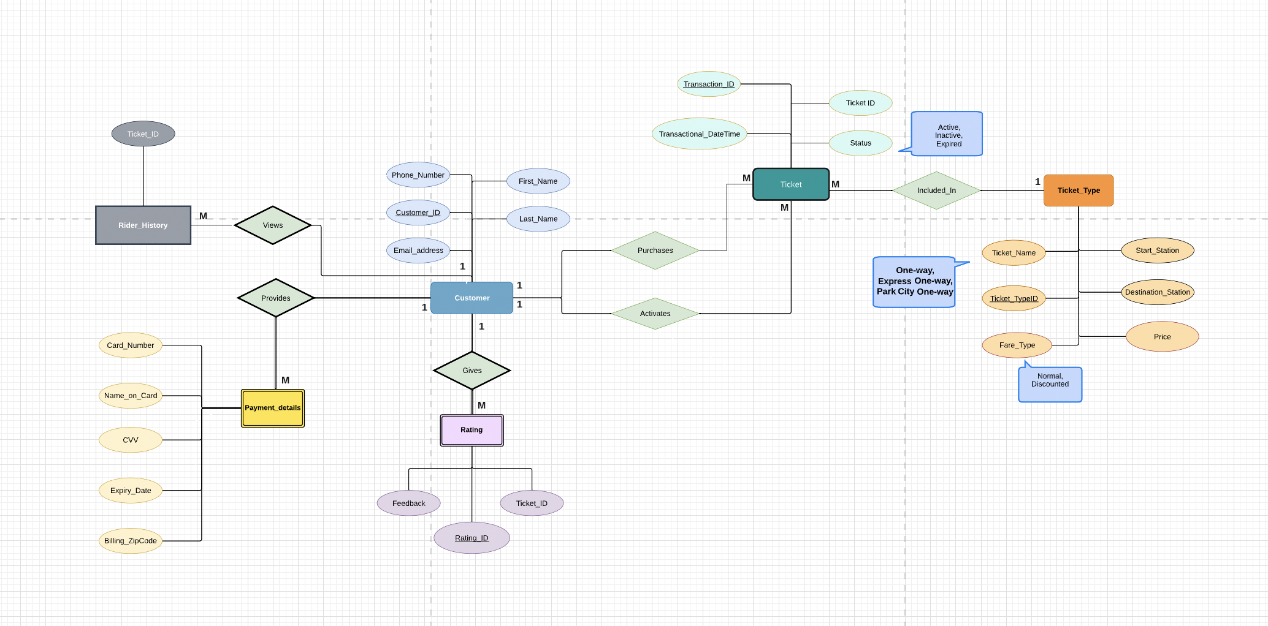
Conceptual Model
The three main entities consist of Customer, Ticket, Ticket_Type and two weak entities Payment details and Rating. CUSTOMER_ID uniquely identifies the Customer entity.
Our model consists of three types : One-way, Express and Park City. Each type is identified by a unique TICKET_ID.
Among the cardinality constraints, there is a 1 to many relationship between Customer and Ticket since a customer can buy multiple tickets, but the vice versa isn’t true.
The weak entities Payment Details and Rating, cannot exist without the Customer. They both cannot exist without a customer entity record associated with them.
The customer can also provide multiple ratings which can be used to track the performance of the app from customer perspective.

Slide 6
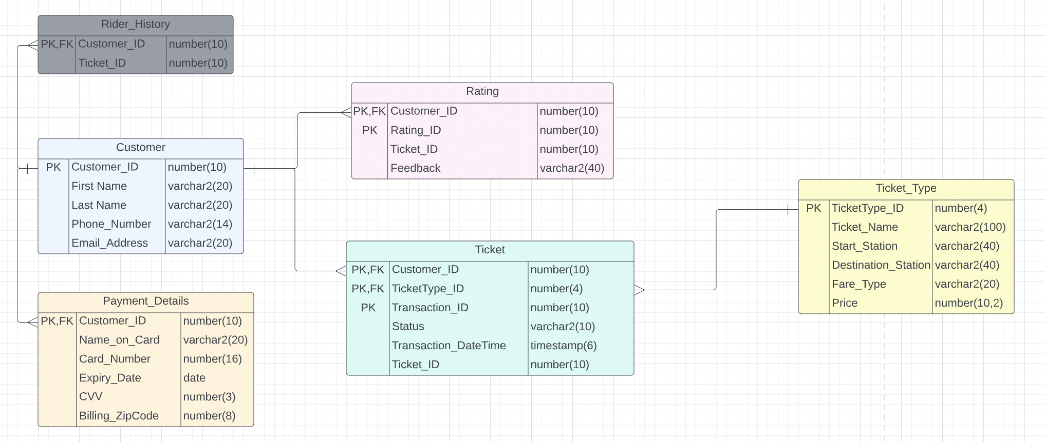
LOGICAL MODEL
The ticket table has 2 foreign keys Customer_Id and TicketType_ID from Customer and Ticket_Type table.
The Ticket table has the most attributes which helps to further monitor the status and datetime details of updation of the ticket status.
In Customer table, we are tracking information like First and Last Name, Phone Number and Email address from customer. This is useful when generating a Customer ID.

Slide 7
PHYSICAL MODEL

Slide 8
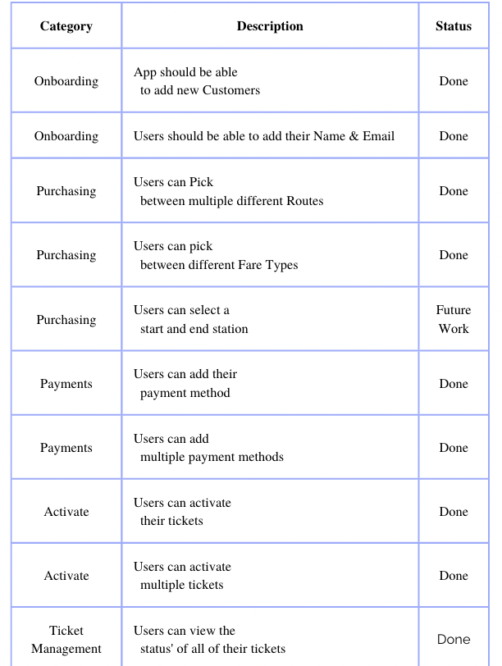
FINAL REQUIREMENTS

Slide 9
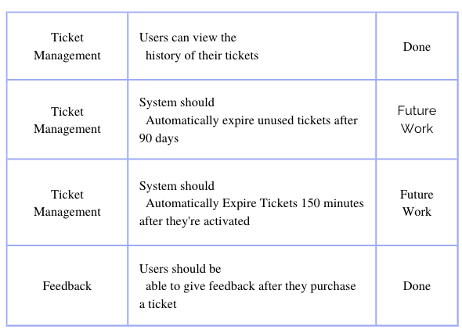

Slide 10
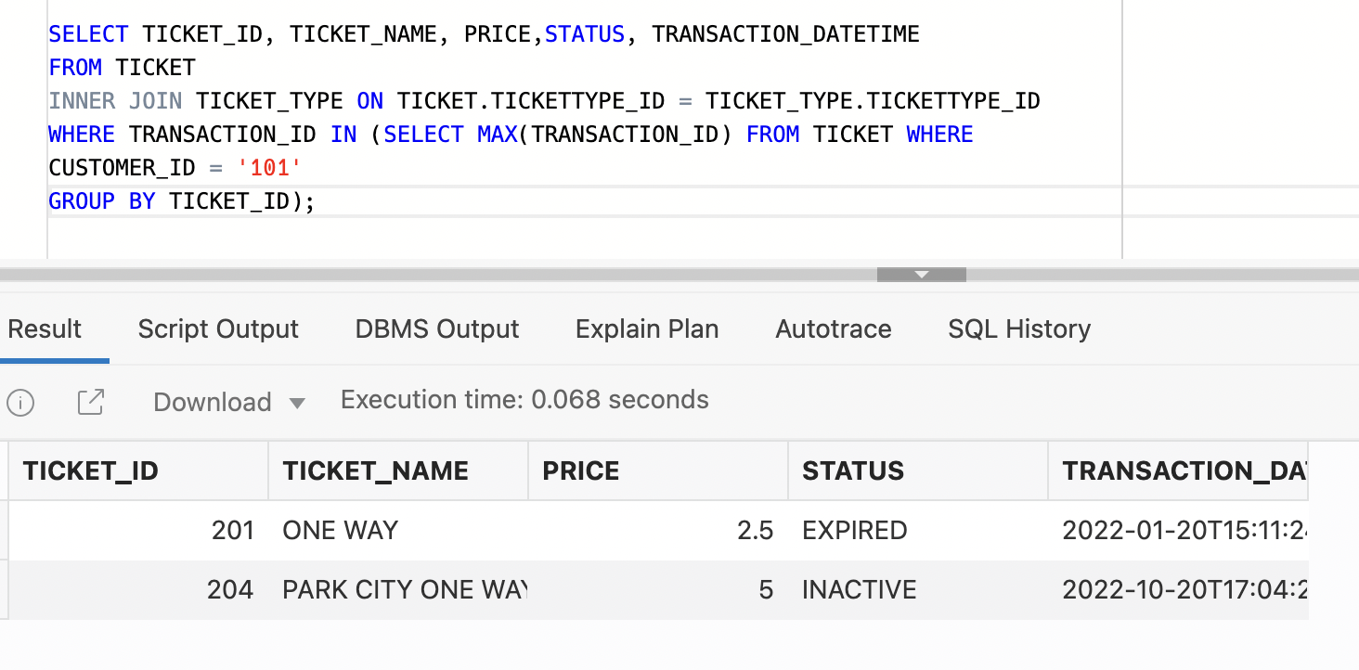
FEATURE 1 - DEMONSTRATION

Slide 11
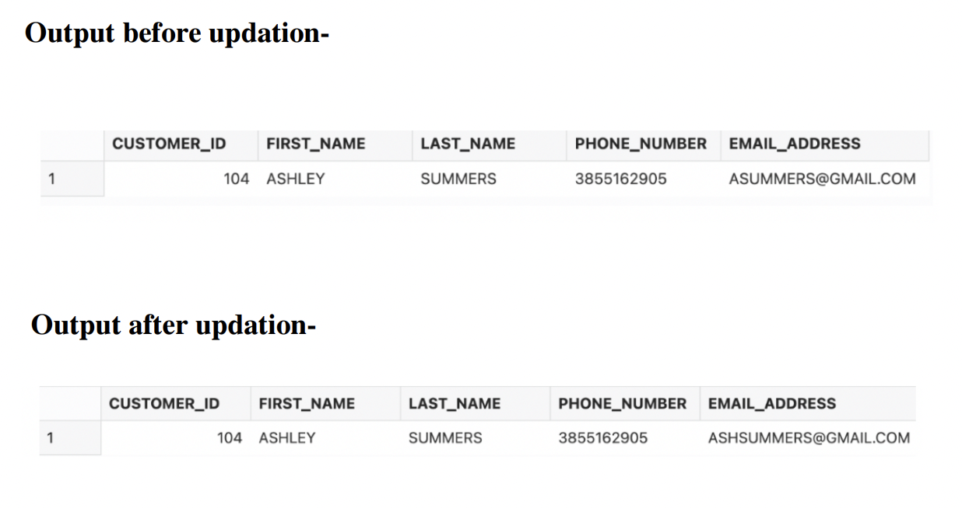
FEATURE 2 - DEMONSTRATION

Slide 12
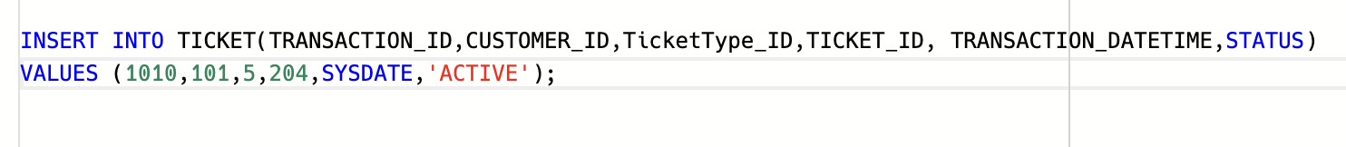
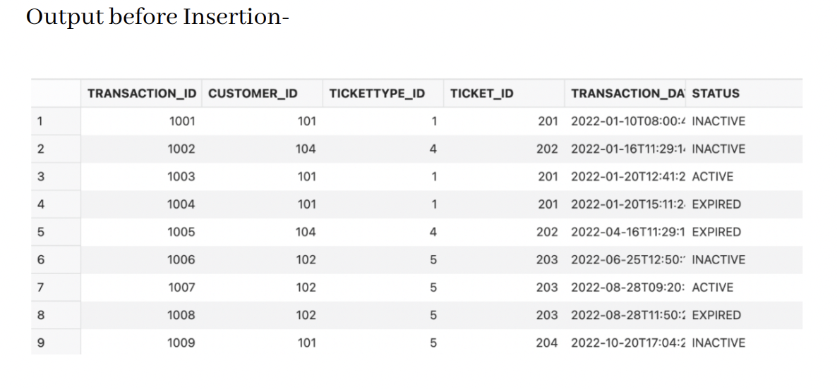
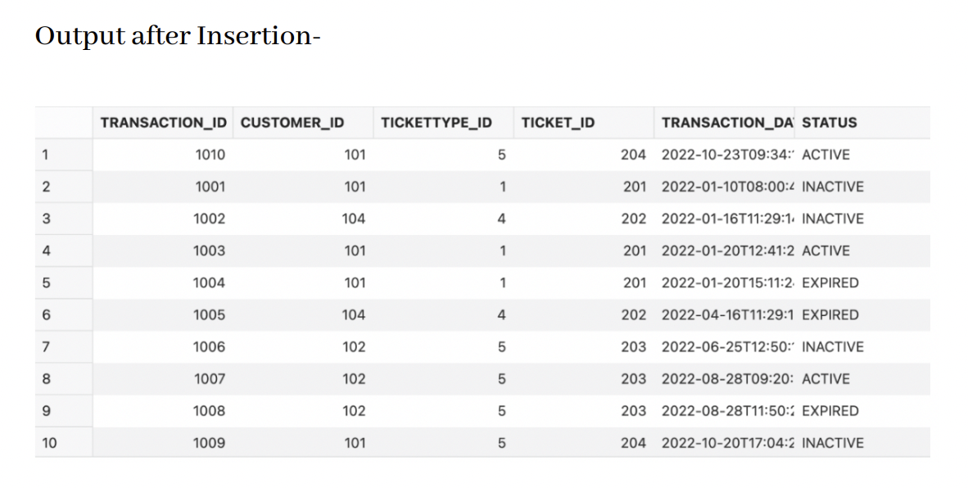
FEATURE 3 - DEMONSTRATION

Slide 13
THANK YOU

